Slide 1

TOWN OF STONEHAM
FISCAL YEAR 2024 CLASSIFICATION PRESENTATION
December 5, 2023
Presented by
Stoneham Board of Assessors
Craig J. Celli, Chairman
Eric Josephson, Secretary
William Jordan, Member
Cheryl Kozlowski, Director of Assessing
Nicholas Coscia, Administrative Assistant

Slide 2
TAX CLASSIFICATION HEARING - PURPOSE
We are here in accordance with Mass General Law Ch. 40 Sec. 56, to present information to the Select Board so that they may determine the percentages of the tax levy to be paid by each class of real and personal property and whether to allow a residential exemption and/or a small commercial exemption for FY24.
The Select Board must vote a Residential Factor, which will determine the percentage of the tax levy to be allocated and paid by the residential property owners.
Votes Required by the Select Board
1. Selection of a Minimum Residential Factor
2. Granting of a Residential Exemption
3. Granting of a Small Commercial Exemption

Slide 3
IMPORTANT TERMS
TERM | DEFINITION
Levy | The property tax levy is the revenue a community can raise through real and personal property taxes.
Levy Limit | The maximum a community can levy in a given year equal to last year’s levy plus 2.5% plus new growth plus override / exclusion if applicable.
Levy Ceiling | Equal to 2.5% of the total full and fair cash value of all taxable real and personal property in the community.
New Growth | Increase in the tax base due to new construction, parcel subdivisions, condominium conversions and property renovations but not due to revaluation. It is calculated by multiplying the increased assessed valuation by the prior year’s tax rate for the appropriate class of property.
Override | A permanent increase to a community’s levy limit.
Override Capacity | The difference between a community’s levy ceiling and its levy limit. It is the maximum amount by which a community may override its levy limit.
Debt Exclusion | A temporary increase over the levy limit for the payment of a specific debt service item over a specific period of time.
Capital Outlay Expenditure | A temporary exclusion for the purpose of raising funds for capital project costs.
Excess Levy Capacity | The difference between the actual levy and the levy limit.

Slide 4
Selection of a Residential Factor
Selecting a residential factor of “1” would adopt a single tax rate for all Residential, Commercial, Industrial and Personal Property classes. If a factor of “1” were to be adopted, the single tax rate for all classes would be $11.52
CLASS | Valuation by Class | % of Shares of Total Tax Levy No Shift
Residential | 5,134,867,508 | 90.2466%
Open Space | 0 | 0.0000%
Commercial | 420,878,111 | 7.3970%
Industrial | 38,263,300 | 0.6725%
Personal Property | 95,812,308 | 1.6839%
TOTAL VALUE | 5,689,821,227 | 100.000%

Slide 5
Selecting a Residential Factor
Selection of a residential factor less than “1” will shift the tax burden from the Residential / Open Space (RO) class to the Commercial, Industrial, and Personal Property class (CIP). The greater the shift selected (see Table below) the greater the percentage of the tax levy is shifted to the CIP property class.
For Fiscal Year 2024, The average single-family property value is $709,434 and the average commercial/industrial property value is $1,494,619.
The FY23 Average Single Family Value was $655,919 x $11.10 = $7,281
The FY23 Commercial/Industrial Value was $1,432,916 x $21.16 = $30,321
Residential Factor | CIP Shift | RES % | CIP % | RES TAX RATE | CIP Tax Rate | Avg Single Family Tax Bill | Avg Single Family Tax difference | Avg CI Tax Bill | Avg CI Tax difference
100.000000 | 100 | 90.2466 | 9.7534 | 11.52 | 11.52 | $8,173 | $892 | $17,218 | -$13,103
0.945962 | 150 | 85.3699 | 14.6302 | 10.90 | 17.29 | $7,733 | $452 | $25,842 | -$4,479
0.935155 | 160 | 84.3946 | 15.6054 | 10.78 | 18.44 | $7,648 | $367 | $27,561 | -$2,760
0.924347 | 170 | 83.4192 | 16.5808 | 10.65 | 19.59 | $7,555 | $274 | $29,280 | -$1,041
0.918943 | 175 | 82.9315 | 17.0685 | 10.59 | 20.17 | $7,513 | $232 | $30,146 | -$175
This table summarizes various shift options and their effect on the average SF tax bill and the average commercial tax bill
Board of Assessors recommends the Select Board adopt the minimum Residential Factor of 0.918943 with corresponding CIP Shift of 175% to afford the residential taxpayers the maximum amount of tax relief. The adoption of this recommendation allows the town to assess and collect an equitable amount of taxes from the residential, industrial and personal property sectors.

Slide 6
Granting a Residential Exemption
The Select Board may grant a residential exemption for all residential properties that are owner occupied and can range up to 35% of the average assessed value of all class one residential parcels.
The amount of the tax levy paid by the residential class remains the same. However, because the residential portion of the levy is distributed over less assessed value, this results in a higher tax rate for the entire residential class. The higher tax rate creates a shift within the residential class that reduces the taxes paid by the homeowners with moderately valued properties. Those taxes are then paid by residential properties owners valued higher than the break-even point (see below), non-owner occupied residential properties and owners of vacant land who would not be eligible for the exemption.
If the full 35% exemption were adopted, the residential tax rate would rise from $10.59 to an estimate of $15.57.
 | PROPERTY BELOW BREAK-EVEN POINT | BREAK-EVEN POINT | PROPERTY ABOVE BREAK-EVEN POINT | Non-Resident Properties Average SF Value | Non-Resident Properties
ASSESSED VALUE | 709,434 | 752,803 | 800,000 | $709,434 | $550,000
TAX RATE | $10.59 | $10.59 | $10.59 | $10.59 | $10.59
TAX BILL | $7,513 | $7,972 | $8,472 | $7,513 | $5,825
ASSESSED VALUE | 709,434 | 752,803 | 800,000 | $709,434 | $550,000
EXEMPTION | 240,718 | 240,718 | 240,718 | 0 | 0
NET VALUE | 468,716 | 512,084 | 559,282 | $709,434 | $550,000
TAX RATE with Exemption | $15.57 | $15.57 | $15.57 | $15.57 | $15.57
TAX BILL | $7,297 | $7,972 | $8,707 | $11,045 | $8,564
SAVINGS/COST | -216 | 0 | 235 | 3,532 | 2,739
WITHOUT EXEMPTION
WITH EXEMPTION

Slide 7
Municipality | Residential Exemption Percentage
Barnstable | 20%
Boston | 35%
Brookline | 20%
Cambridge | 30%
Chelsea | 35%
Concord | 10%
Everett | 25%
Malden | 30%
Mashpee | 5%
Nantucket | 25%
Oak Bluffs | 8%
Provincetown | 35%
Somerville | 35%
Tisbury | 22%
Truro | 30%
Waltham | 35%
Watertown | 33%
Wellfleet | 30%
The residential exemption has been adopted by only 18 communities within the state of Massachusetts. The table on the left details the communities that have adopted a residential exemption. The majority of these are communities with non-owner occupied rental properties and/or vacation homes.
Recommendation
Granting a residential exemption benefits those communities that have a substantial number of non-owner occupied properties such as rental properties, apartment buildings and vacation homes. In Stoneham, most all residential parcels are the principal residences of the taxpayer, there is little to no benefit in adopting a residential exemption in Stoneham.
The Board of Assessors does not recommend a Residential Tax Exemption of any percentage.
* Percentage of owner-occupied properties have been estimated using the mailing address of the property’s real estate tax bill.

Slide 8
Granting a Small Commercial Exemption
The Select Board may grant a Small Commercial Exemption up to 10% of the total property valuation to commercial properties (300 class) that have an average annual employment of not more than 10 people and an assessed valuation of less than $1,000,000.
Every business occupying the parcel must qualify.
 | 5% Exempted | 10% Exempted
Number of Qualifying Parcels | 56 | 56
Valuation Exempted | $1,385,910 | $2,771,820
Tax Dollars Exempted | $27,939.95 | $55,879.89
Revised CI Tax Rate / 1000 | $20.23 | $20.29
Increase in Tax Rate | $0.06 | $0.12
Impact Summary and recommendation: Granting a small commercial exemption will increase the tax rate and will shift the tax burden within the C/I Class, from small commercial properties to larger commercial and industrial properties. Also, small commercial exemption would not necessarily benefit tenants, as the exemption is granted to the property owner, not the individual businesses.
The Board of Assessors does not recommend a Small Business Exemption of any percentage.

Slide 9
5 YEAR VALUATION – AVERAGE TAX BILL

Slide 10
Stoneham CIP Shift & Tax Rate History
Fiscal Year | % of Tax Base Residential (Unshifted) | % of Tax Base CIP (Unshifted) | Single Tax Rate (Unshifted) | Maximum Allowable Shift | shift Selected | % of Tax Base Residential (Shifted) | Residential Tax Rate (Shifted) | % of the Tax Base CIP (Shifted) | CIP Tax Rate (Shifted)
2024 | 90.25% | 9.75% | $11.52 | 175 | 175 | 82.93% | $10.59 | 17.07% | $20.17
2023 | 90.13% | 9.87% | $12.09 | 175 | 175 | 82.72% | $11.10 | 17.28% | $21.16
2022 | 90.33% | 9.67% | $11.32 | 175 | 175 | 83.08% | $10.41 | 16.92% | $19.81
2021 | 90.75% | 9.25% | $11.71 | 175 | 175 | 83.81% | $10.82 | 16.19% | $20.49
2020 | 90.48% | 9.52% | $11.71 | 175 | 175 | 83.34% | $10.79 | 16.66% | $20.50
2019 | 90.43% | 9.57% | $12.19 | 175 | 175 | 83.25% | $11.22 | 16.75% | $21.33
2018 | 90.02% | 9.98% | $11.74 | 175 | 175 | 82.53% | $11.71 | 17.47% | $22.35
2017 | 89.78% | 10.22% | $13.50 | 174 | 172 | 82.45% | $12.39 | 17.55% | $23.21
2016 | 88.47% | 11.87% | $13.75 | 154 | 152 | 82.47% | $12.70 | 17.53% | $22.55
2015 | 88.89% | 11.10% | $13.97 | 160 | 158 | 82.45% | $12.96 | 17.55% | $22.08
2014 | 88.47% | 11.87% | $14.47 | 154 | 152 | 82.47% | $13.49 | 17.53% | $22.00
2013 | 88.13% | 11.87% | $13.99 | 150 | 150 | 82.19% | $13.06 | 17.81% | $21.00
2012 | 88.36% | 11.64% | $13.50 | 152 | 150 | 82.54% | $12.61 | 17.46% | $20.25
2011 | 88.22% | 11.78% | $13.09 | 150 | 150 | 82.35% | $12.21 | 17.65% | $19.63
2010 | 88.65% | 11.35% | $12.33 | 153 | 153 | 82.63% | $11.49 | 17.37% | $18.87
2009 | 88.78% | 11.22% | $11.70 | 155 | 155 | 82.61% | $10.88 | 17.39% | $18.13
2008 | 89.27% | 10.73% | $11.00 | 162 | 161 | 82.72% | $10.19 | 17.28% | $17.70

Slide 11
FISCAL YEAR 2023
Community CIP Tax Shift & Average Single Family Tax Bill Comparison

Slide 12
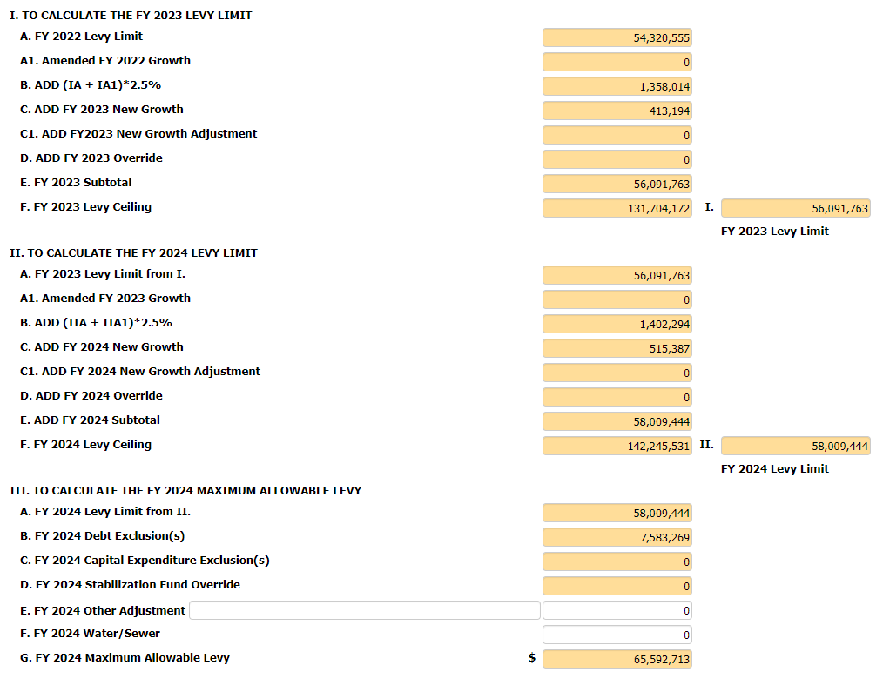
Fiscal Year 2024 – Levy Limit

Slide 13
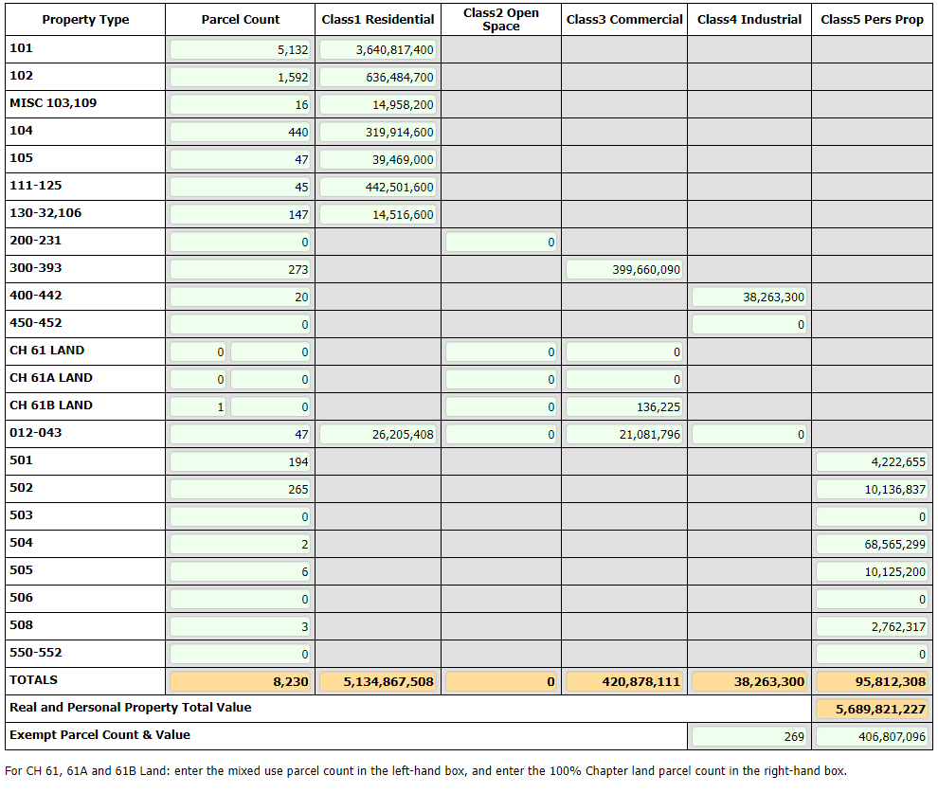
Fiscal Year 2024 - LA-4

Slide 14

Tax Classification Hearing
Questions / Comments
Board of Assessors
781-279-2640
Town Hall
35 Central Street
ckozlowski@stoneham-ma.gov

