Slide 1


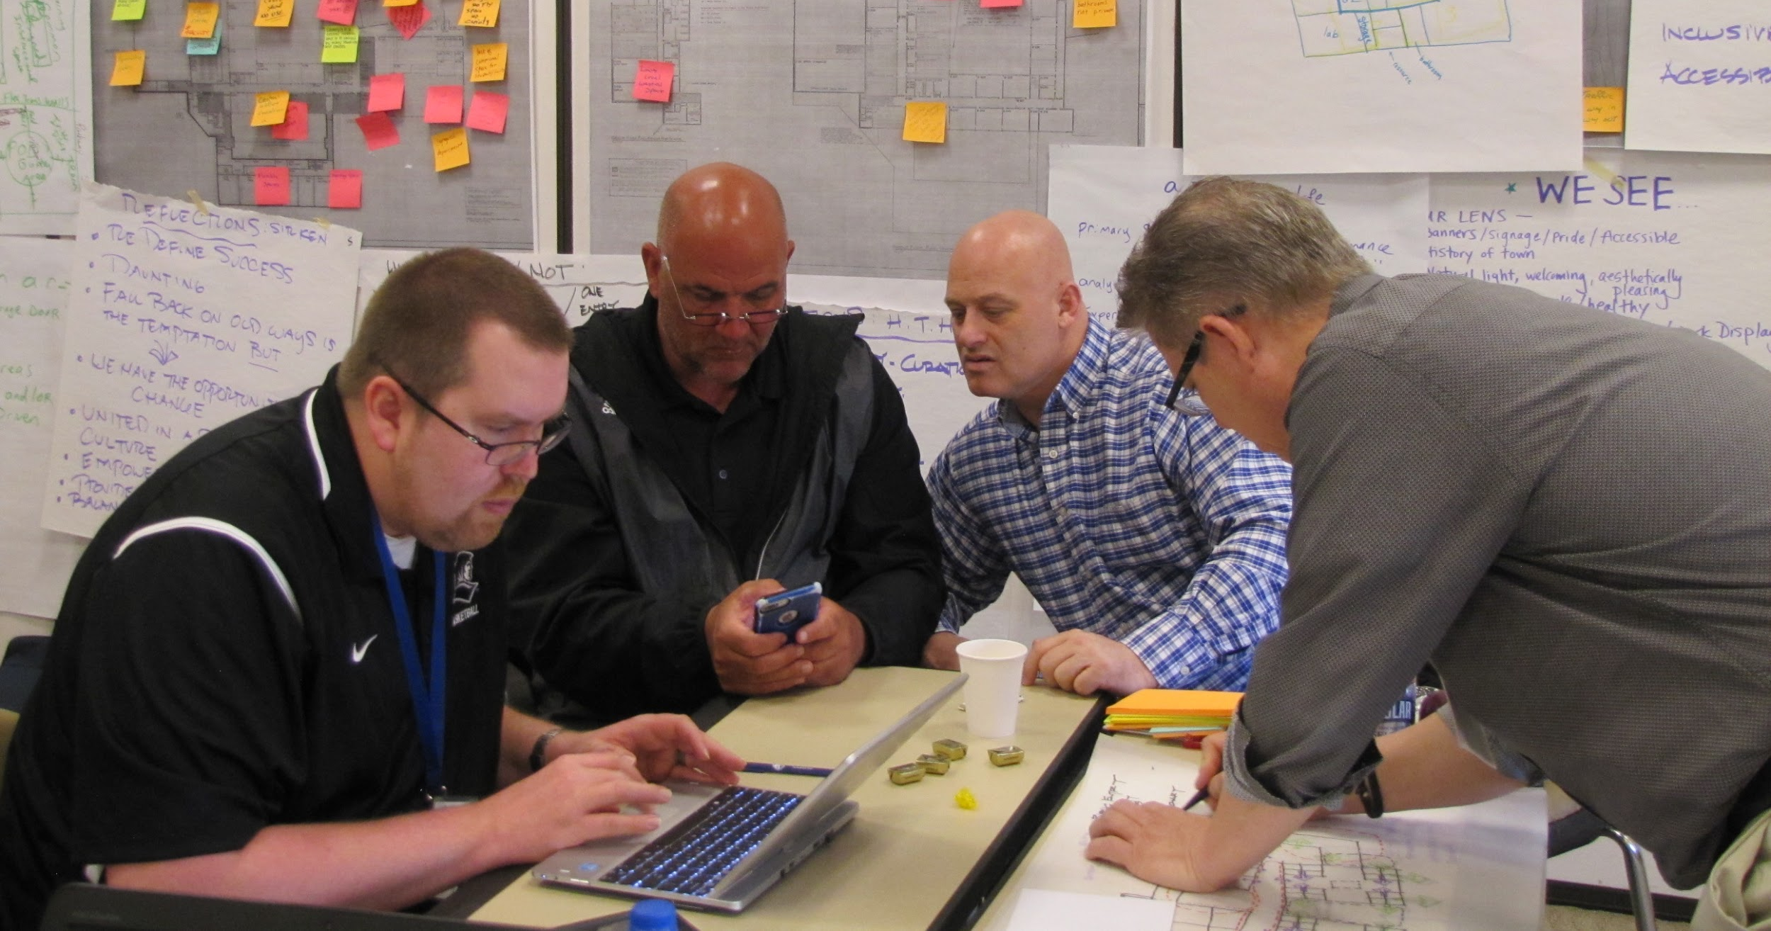
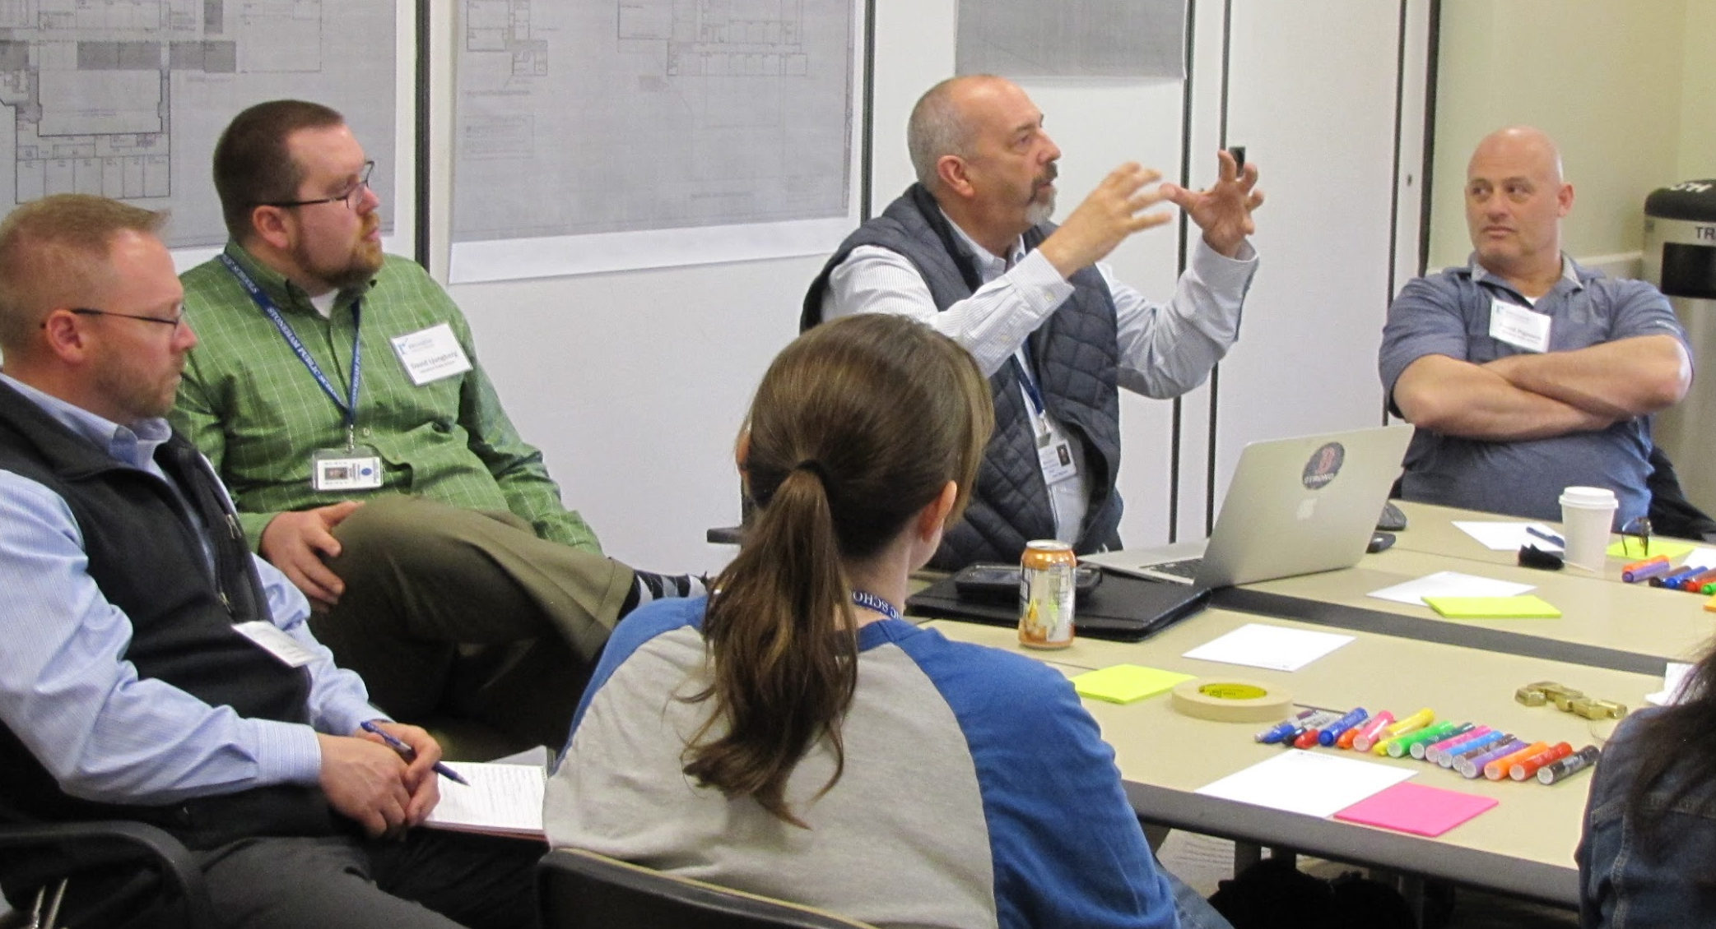
Massachusetts School Design Summit May 9, 2019

Slide 2
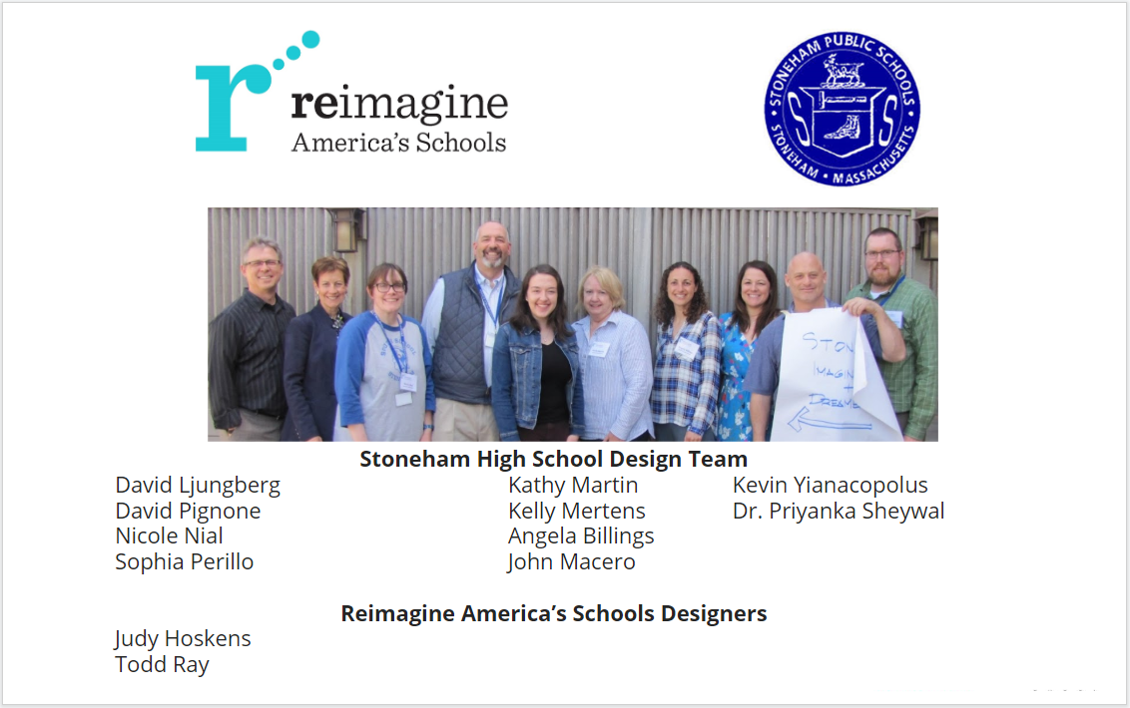

Slide 3

IMAGINE

Slide 4
Our Vision and Hopes
Inspire Curiosity that addresses the “Whole Child”
Safe Spaces
Prioritize Relationships: students, faculty, and community members
Embrace and Develop Community Partnerships

Slide 5
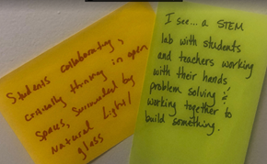
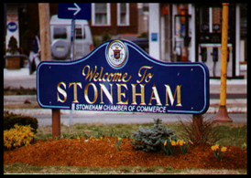
Our Vision and Hopes
Vibrant + State of the Art Facility
Natural Daylight, Views + Connection to the Environment
Transforms future instruction / program
Enriches Interdisciplinary Experiences
Critical thinking, collaboration, creativity and communication
A BUZZ of activity and excitement

Slide 6
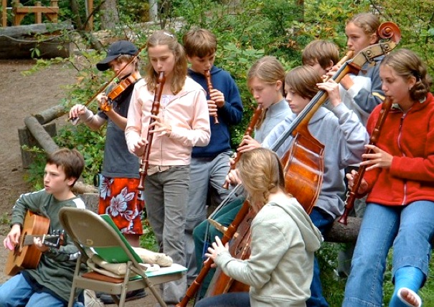
Aspirations
Inclusive
Accessible
Flexible
Forward thinking
Building for the long term
Welcoming, inviting spaces

Slide 7
REFLECTION

Slide 8
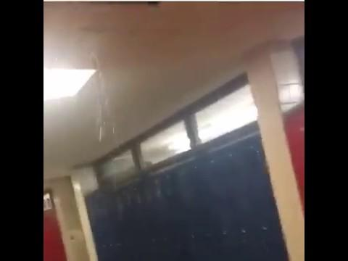
Challenges:
Physical building is “tired”.
Roof Repairs need
Dark halls
Inefficient
Inaccessible
Over crowded
Auditorium ineffective
Science labs antiquated
No STEM instruction space
Pick-up + Drop-off Congestion
Security
“Walk our halls + bring your umbrella!”

Slide 9
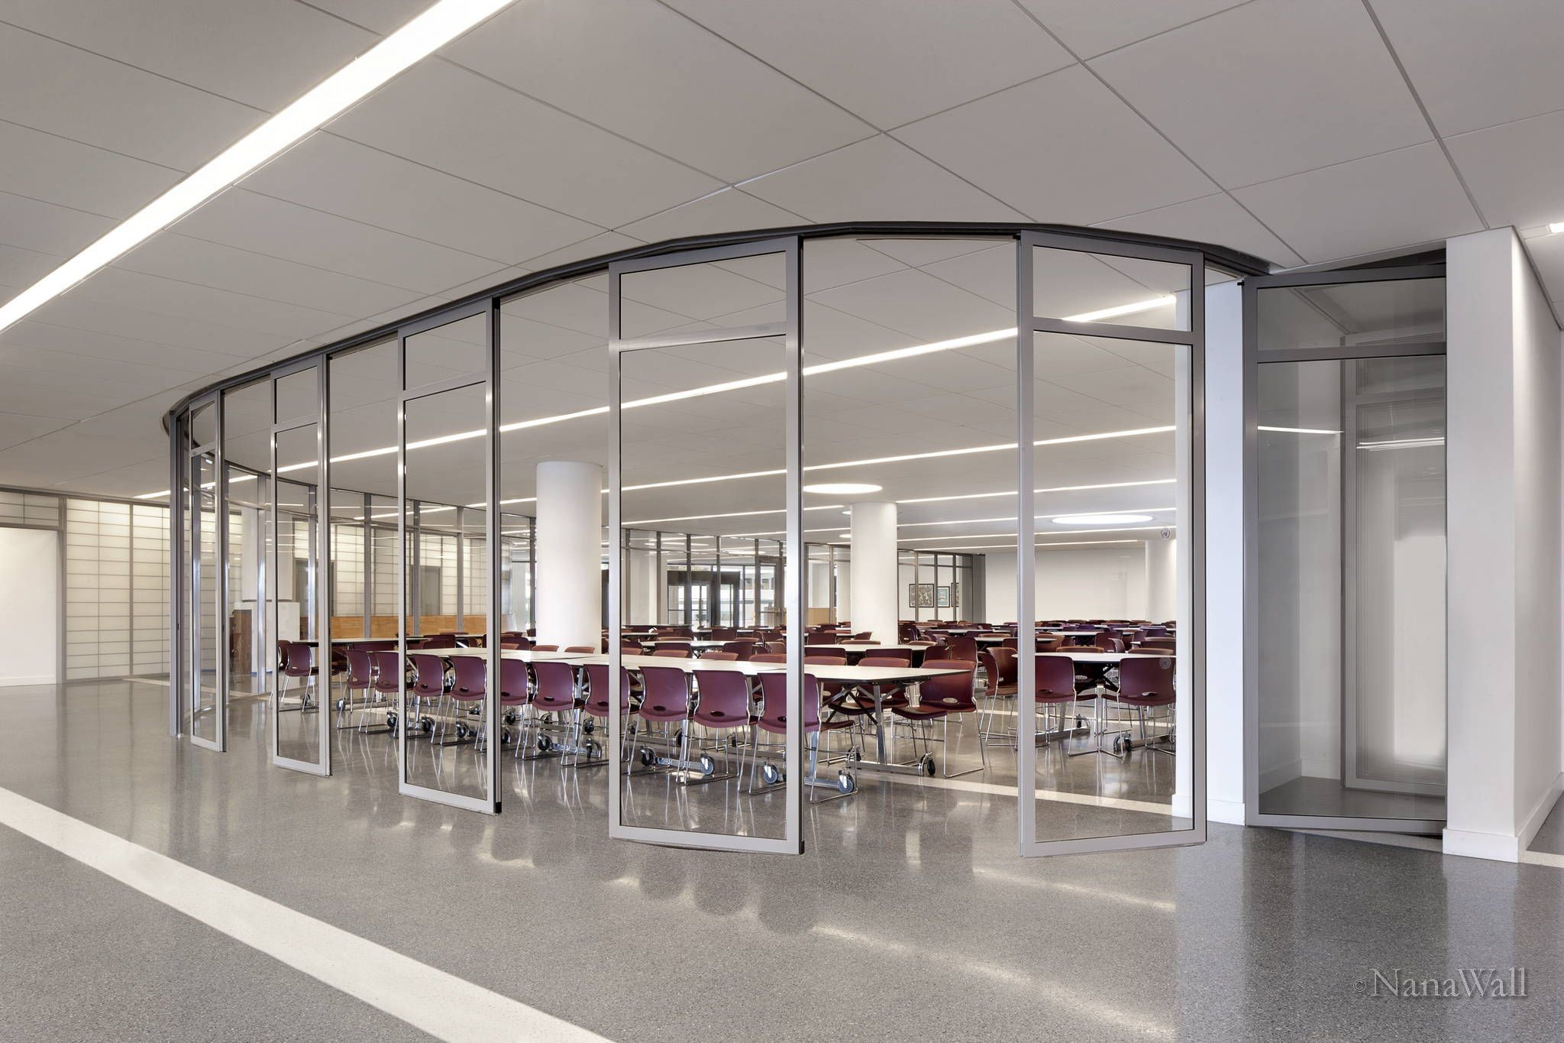
Considerations
We want to redefine success
Opportunity to change
Empower more student voice
Student autonomy
Discipline, Choice, Engagement
School-community connections
Outside space
Inside space
Programming
Athletics
Fine Arts

Slide 10
VISION

Slide 11
We Imagine / We See
Natural lighting Glass walls Moveable walls Open spaces Indoor/outdoor spaces for learning (Landscape Studios) Fully equipped Design Labs with adequate storage space Self sustaining building as part of expeditions Vocational opportunities for all Secure campus Welcoming entryway - open space, light, variety of meeting locations and flexible seating spaces | Student and staff showcasing Ubiquitous, accessible technology Zero waste facility Solar panels Power stations for transportation Spartan Place (Hospitality Pathway) Health and Wellness Informal dining - food court Social area Natural trails, health stations, + ecology stations Community gardens

Slide 12
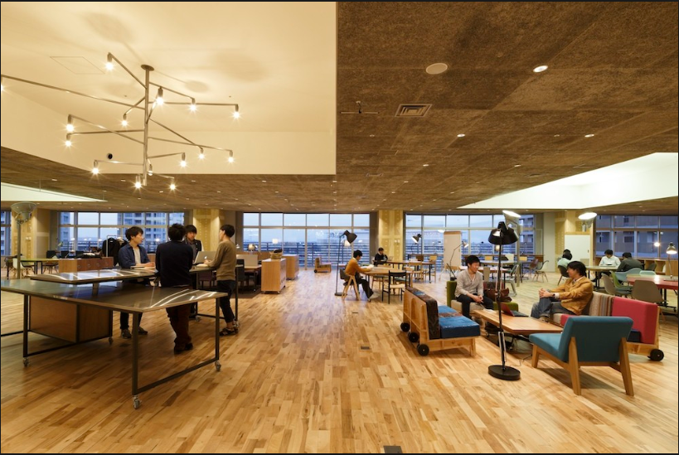
Learning Pathways:
Assessment Center
Life Skills Apartment
Media Commons
Learning Labs Pathways
Biomedical + Computer Sciences
Engineering
Makerspace Fabrication Design Labs
SPARTAN Place
Hospitality Expeditionary Learning
Community Hub
Child Study, Pre/K and Daycare Facility
Integration of Community Partnerships

Slide 13
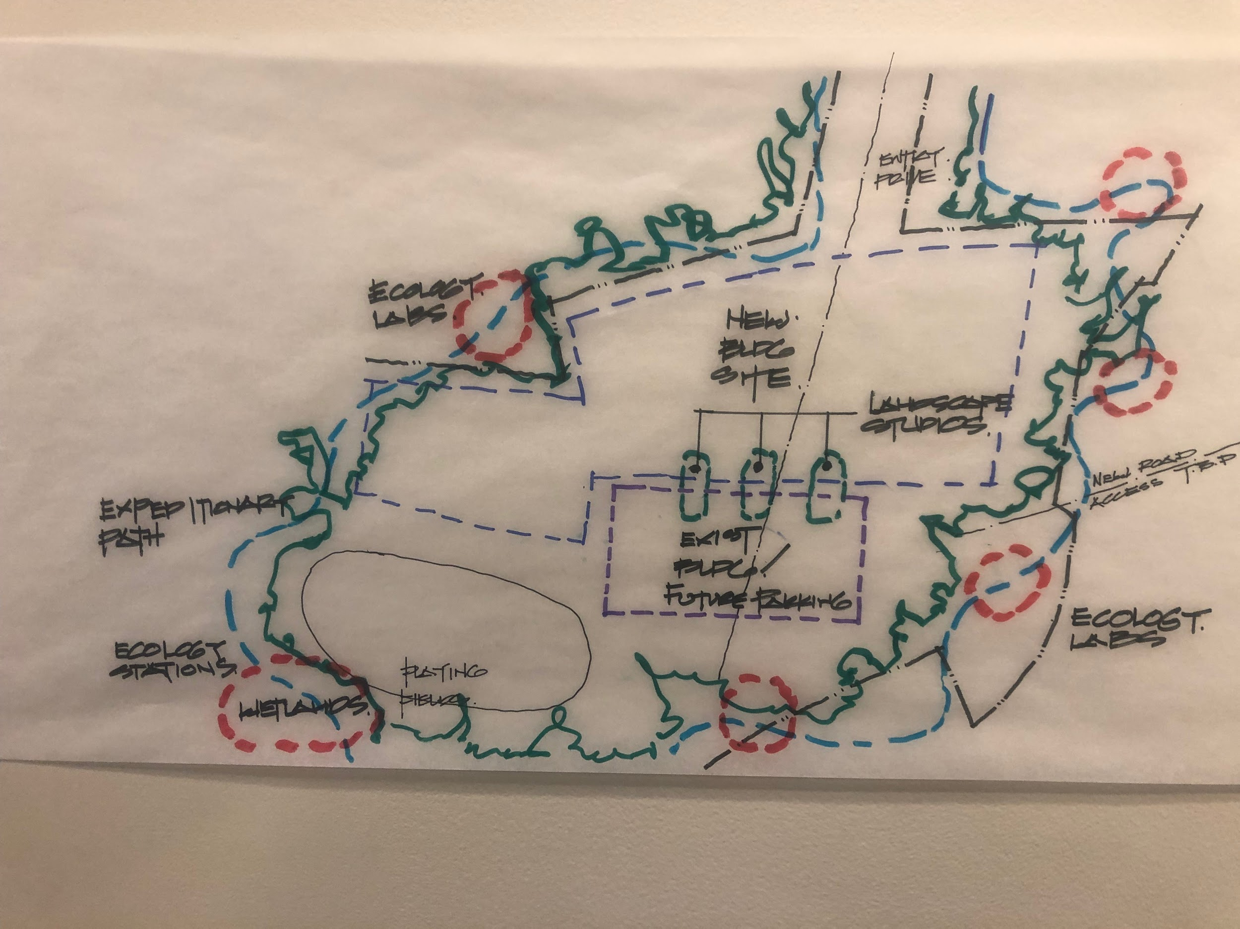
Site Considerations
Landscape Studios
Habitats/Migratory Garden
Expeditionary Pathways
Vernal Pool
Wetlands
Ecology stations
Campus to Table Gardens
Community Garden
Daycare/Playscape

Slide 14
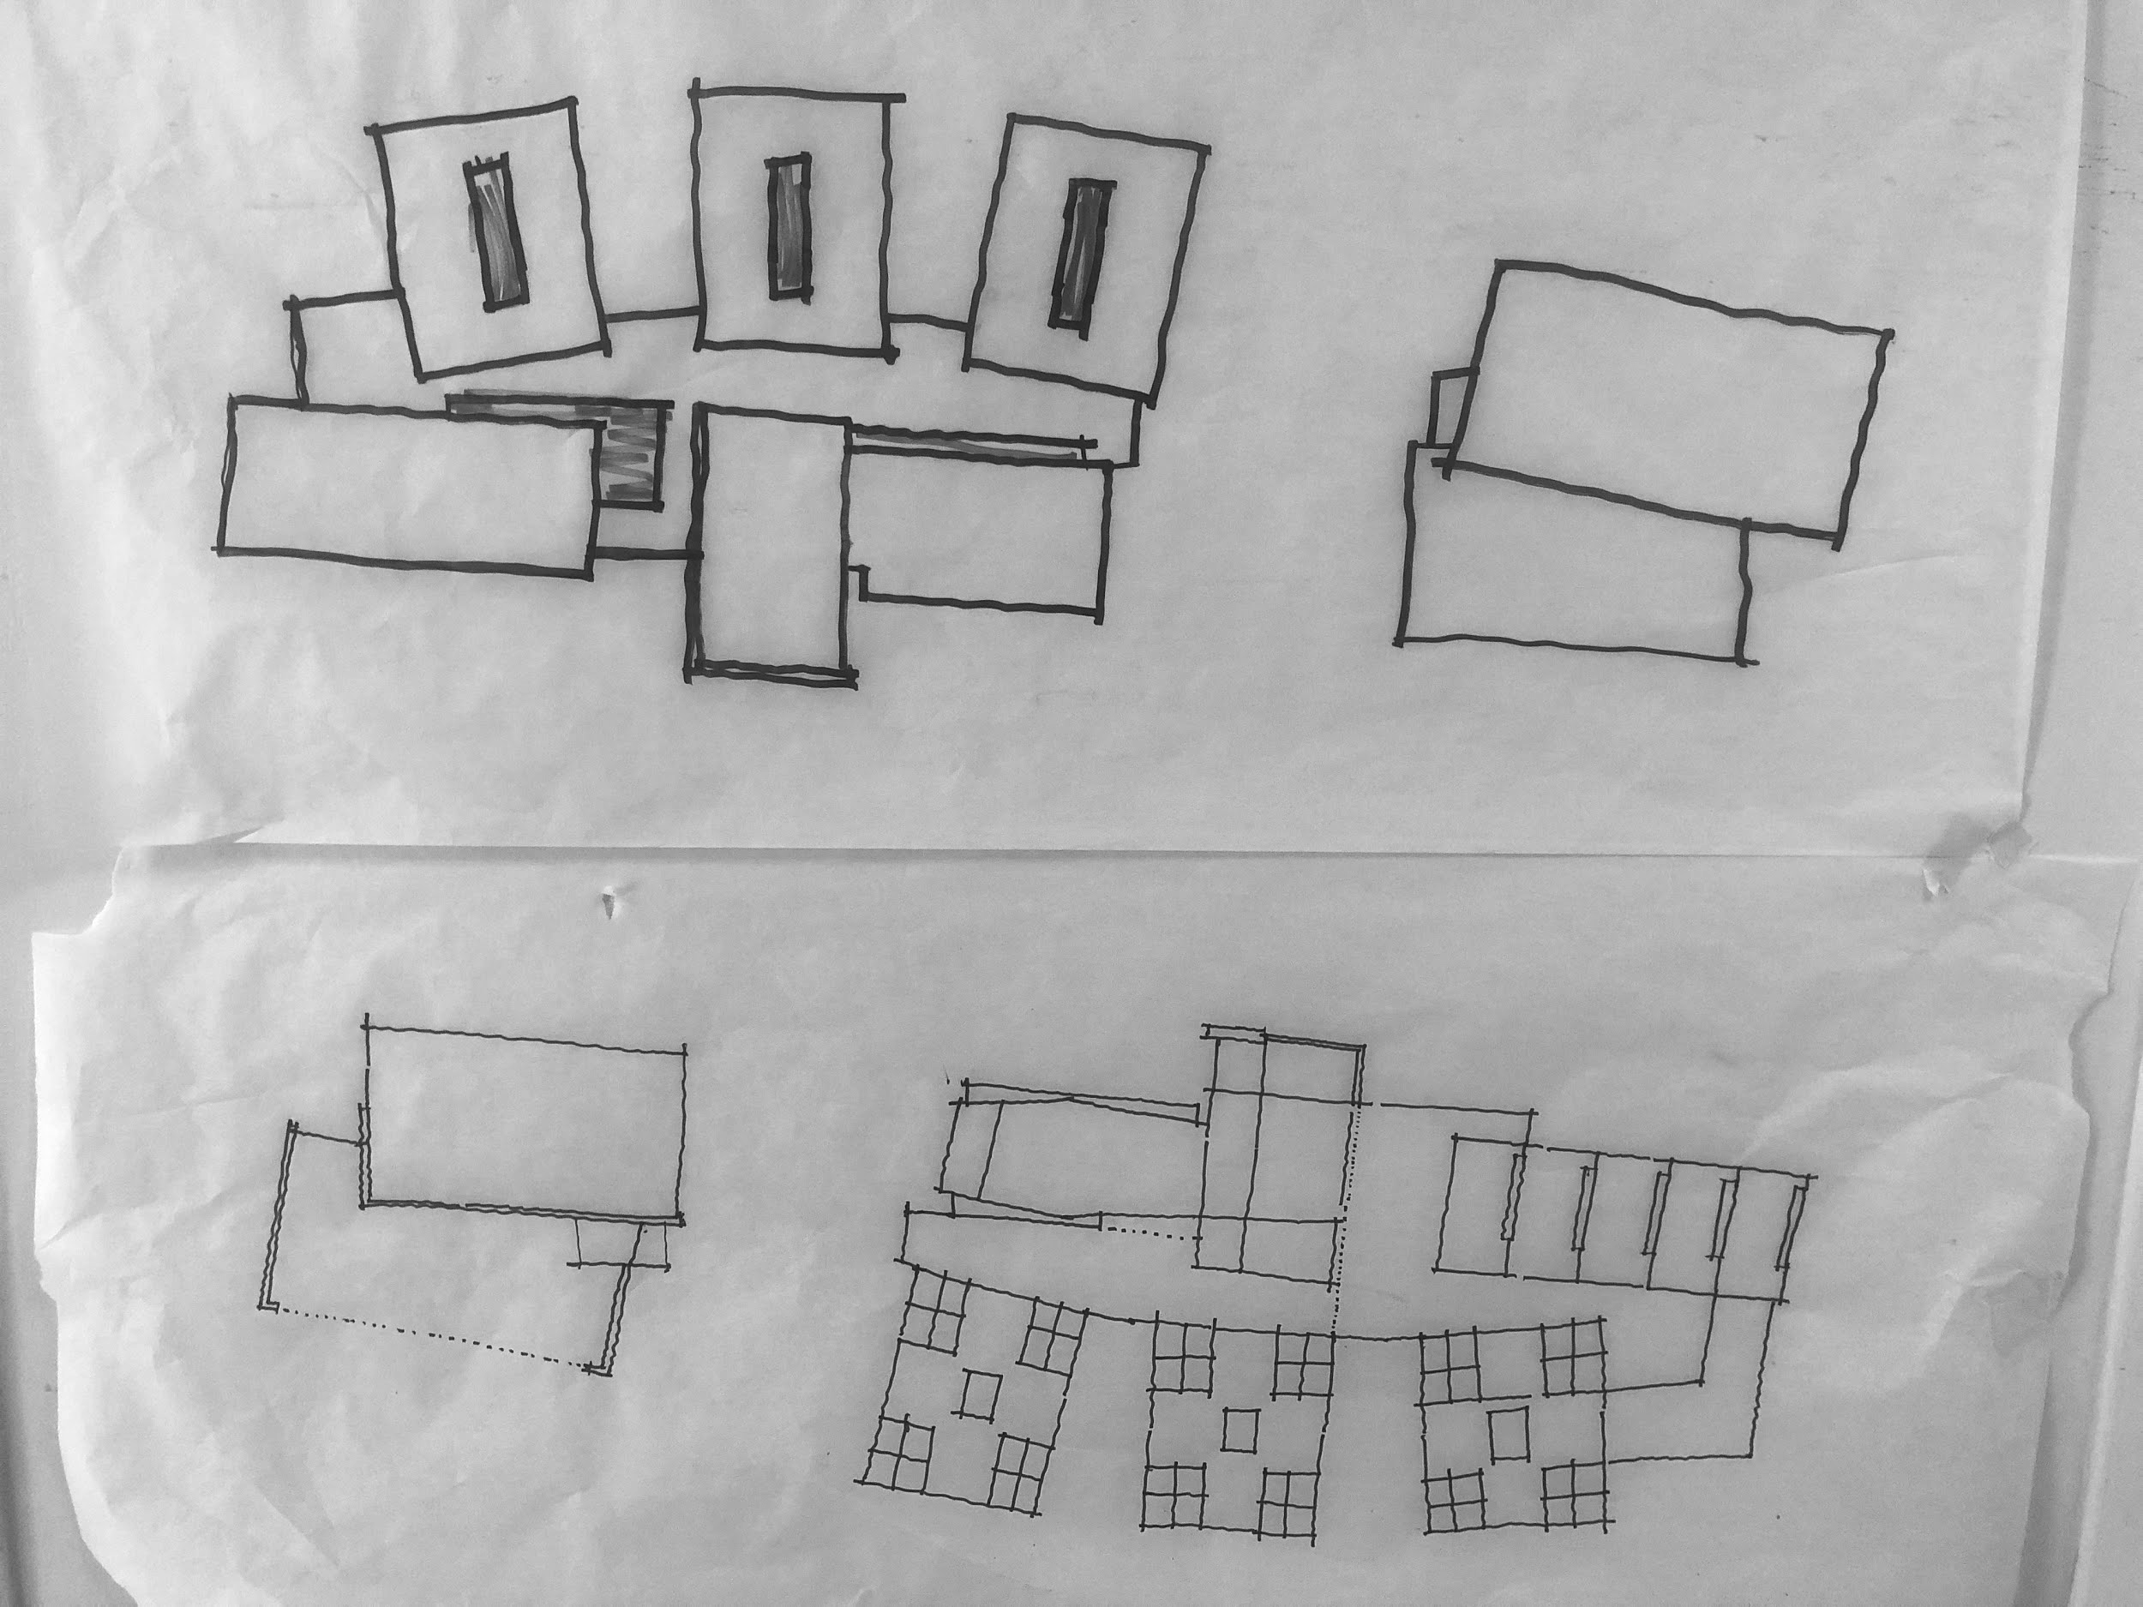
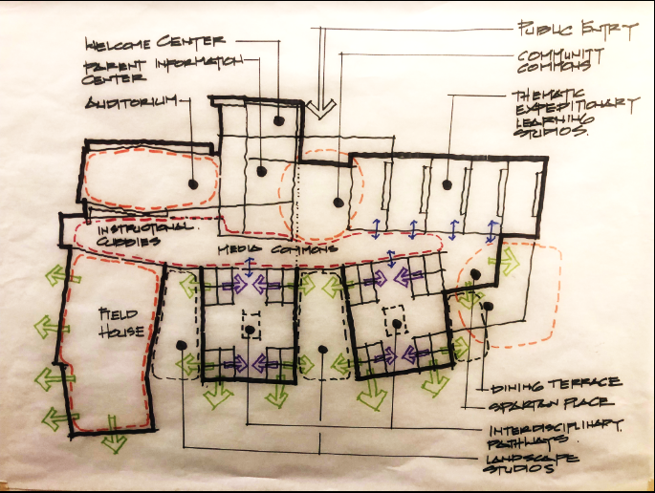
Building Considerations
Welcome Center
Parent Information Center
Community Commons
Research and Fabrication Modules
Exploration, Observation
Connect Study + Landscape Studios
Faculty Collab
Fully Utilized Auditorium
Self-Sustaining Power Plant
Transportation Charging Ports
Rain Water Recycling
Green Roof
2nd + 3rd Iterations
Current Iterations

Slide 15
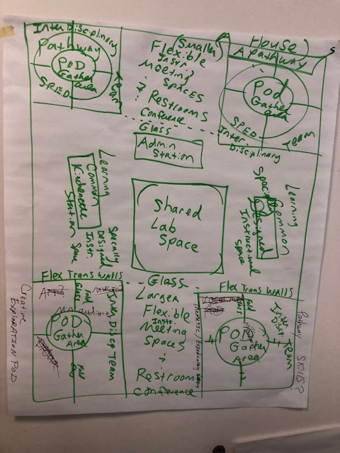
Learning Pathways

Slide 17
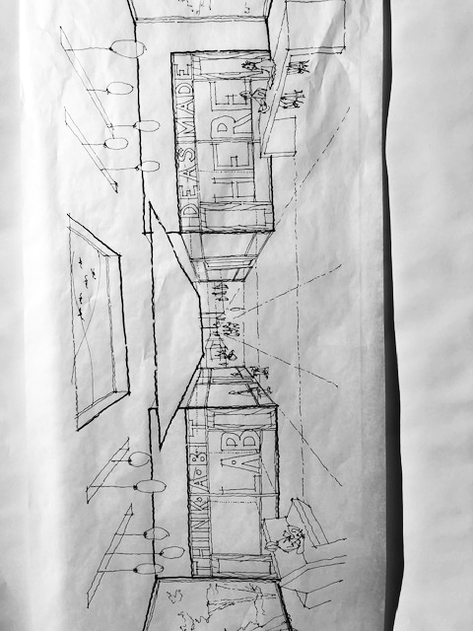
Learning Pathways

Slide 18
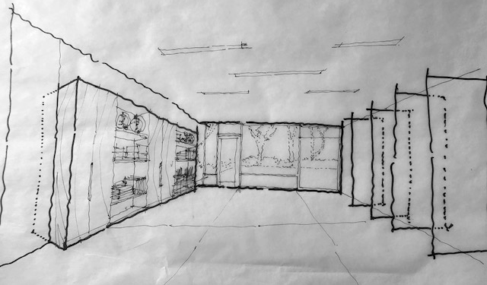
Thematic Expeditionary Learning Studio

Slide 19
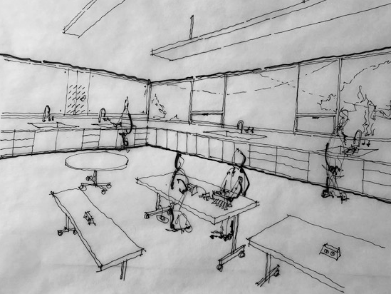
Dedicated Lab Programming

Slide 20
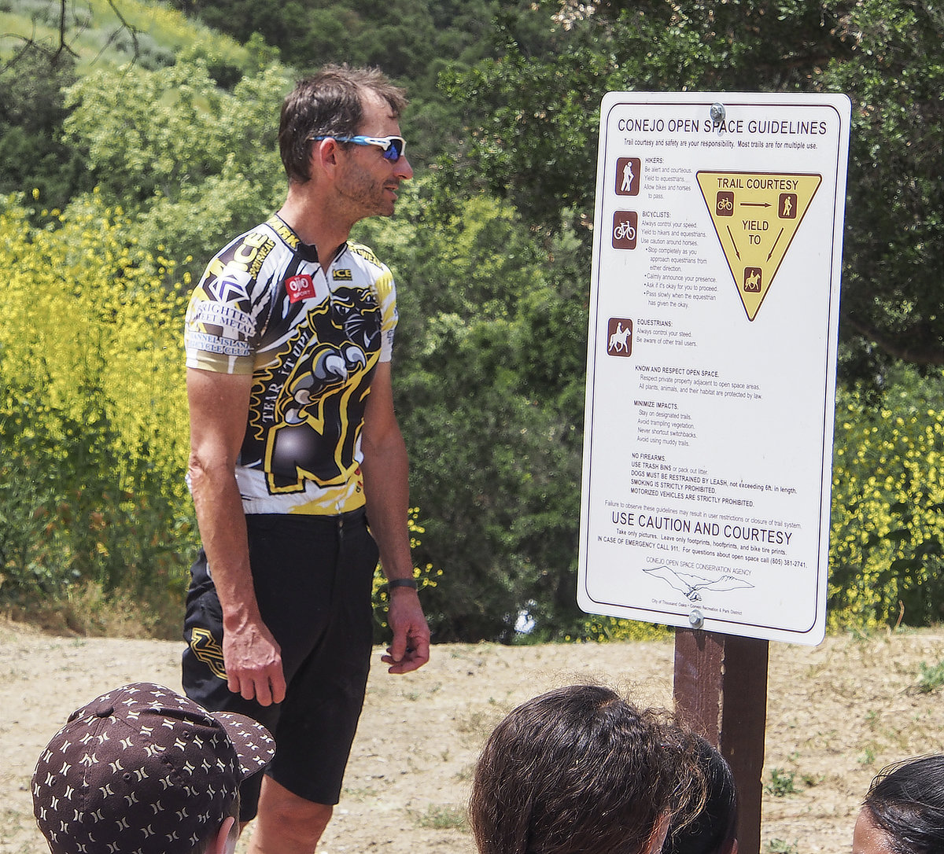
“I see citizens using the outdoor site after school hours for walking groups, ecology tours, performances, & more.”

Slide 21
“Students coming and going from internships and other outside career related places/jobs.”

Slide 22
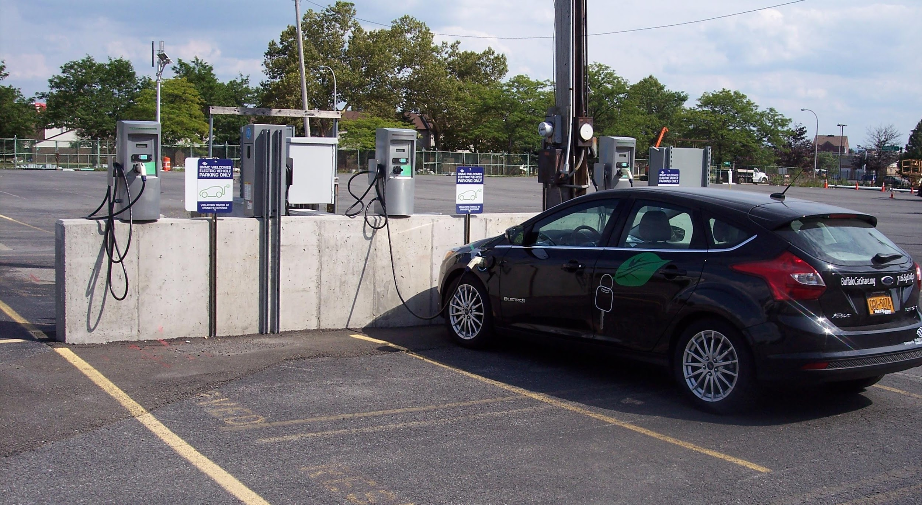
“I see a self sustained physical plant - generating enough electricity to power the building & car charging stations.

Slide 23
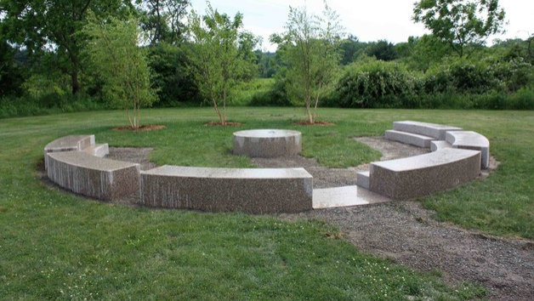
“I see common spaces where classes can collaborate, teachers and faculty can meet and clubs can organize.”

Slide 24
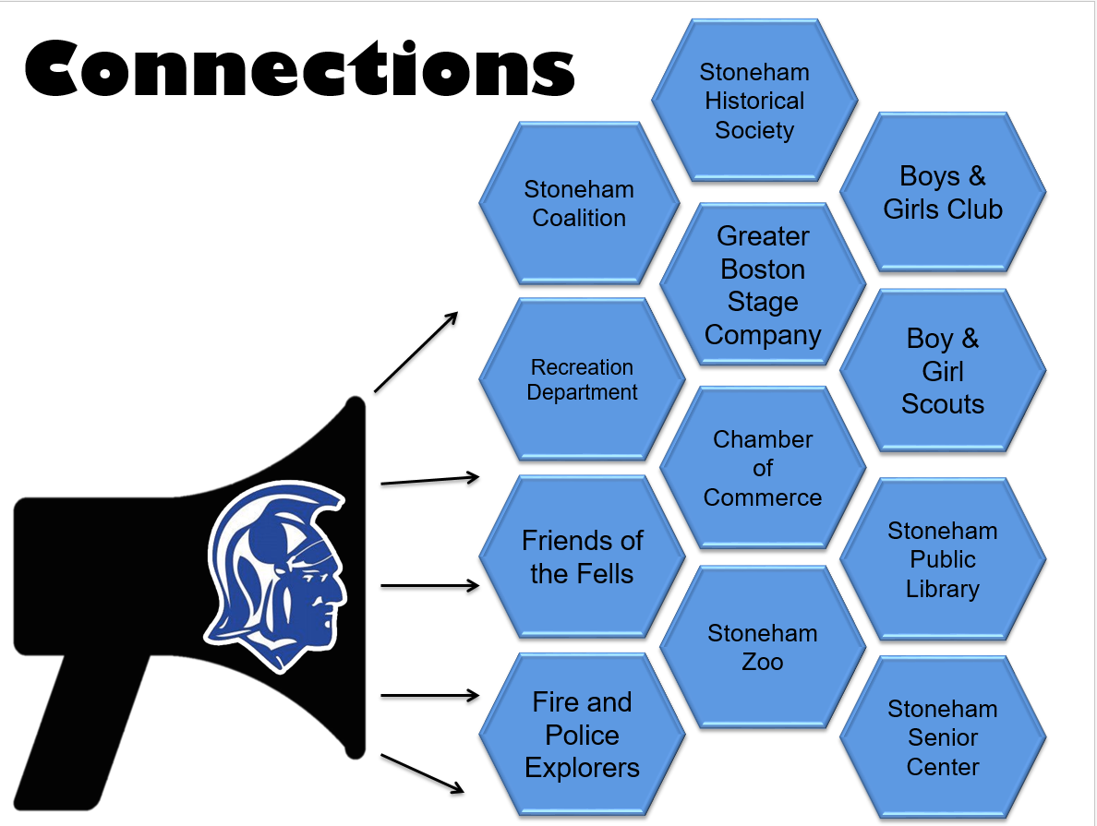
Community Connections

Slide 25
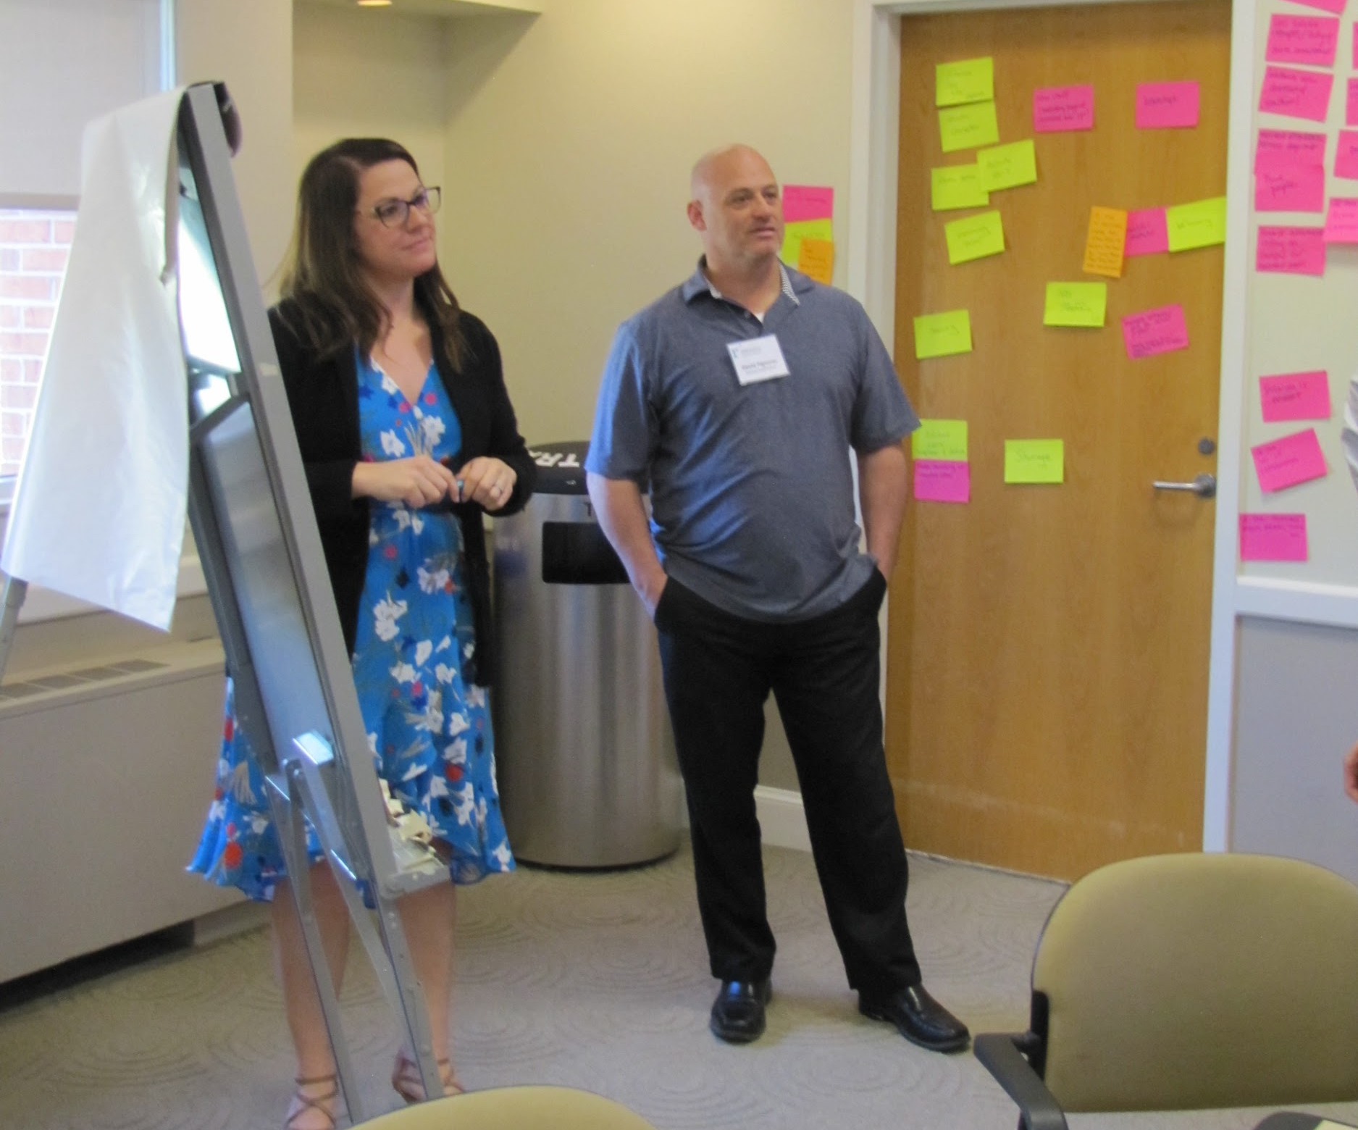
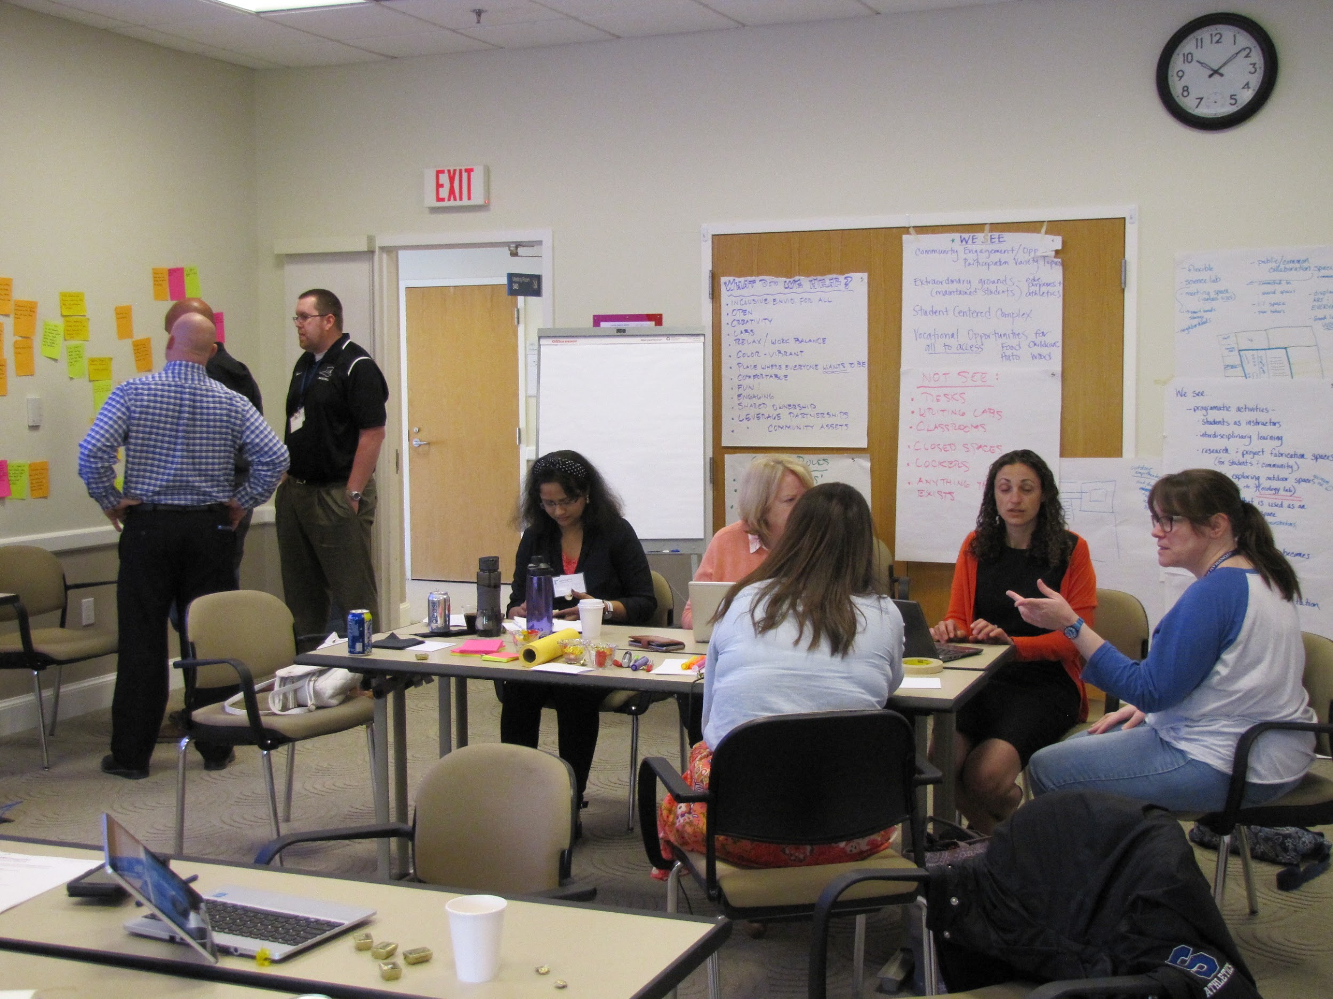
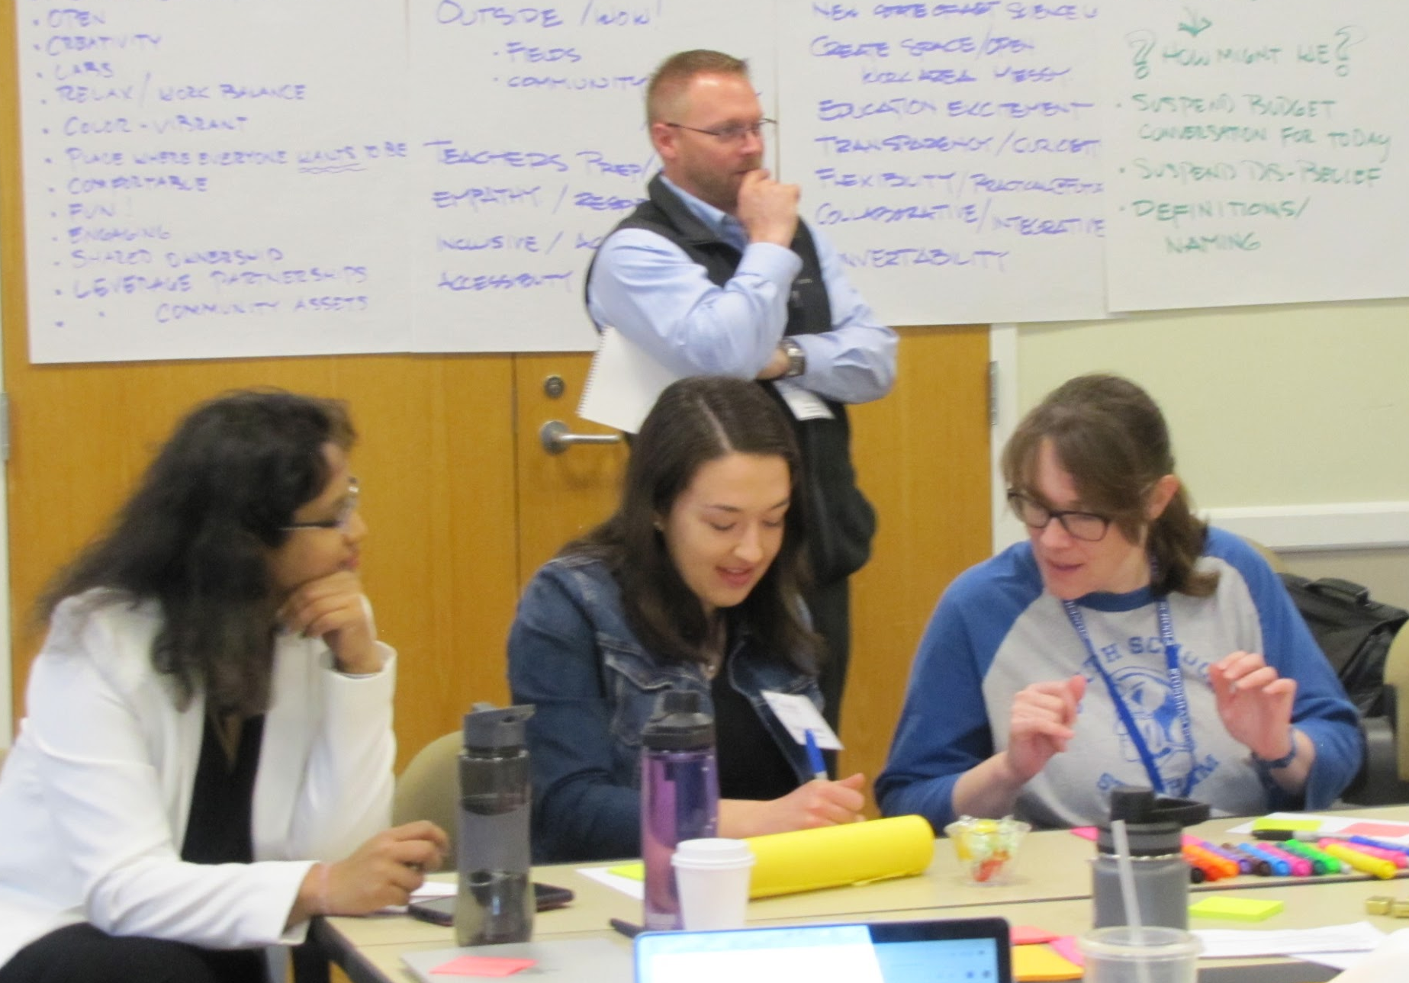
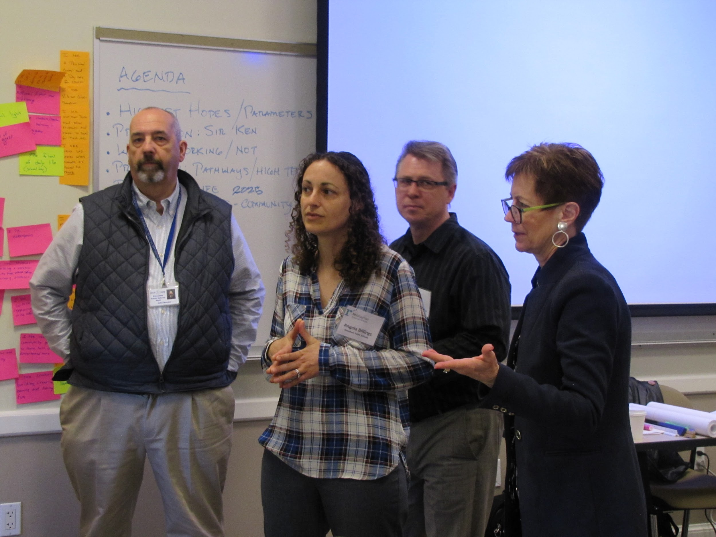
And so
it begins...

